Slide 1
HCI Virtual Reality

Slide 2
Virtual Reality
What is Virtual Reality?
Virtual Reality (VR) is a simulated experience that can be similar to or completely different from the real world. It immerses users in a computer-generated environment using devices such as VR headsets, gloves, or motion tracking systems.
Core Components of VR
1) Immersive Environments
Simulated 3D worlds that users can explore and interact with.
Can mimic real-world settings or create entirely fictional universes.
2) Interaction
Users interact using gestures, voice commands, or handheld controllers.
Interaction design is key to maintaining immersion and user comfort.

Slide 3
Virtual Reality
3) Presence
The feeling of “being there” in the virtual environment.
A critical goal in VR, influenced by realism, responsiveness, and sensory cues.
4) Input Devices
VR headsets (like Oculus, HTC Vive, PlayStation VR)
Motion controllers, gloves, body suits
Eye tracking, hand tracking, haptics
5) Output Devices
Displays inside headsets (stereoscopic 3D visuals)
Spatial audio systems
Haptic feedback devices

Slide 4
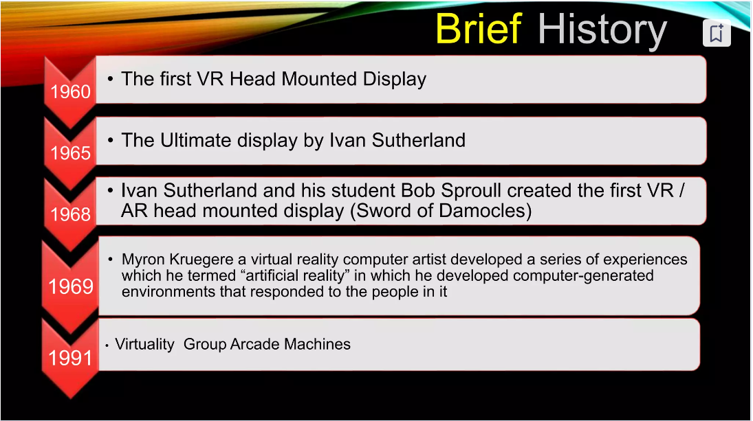

Slide 5
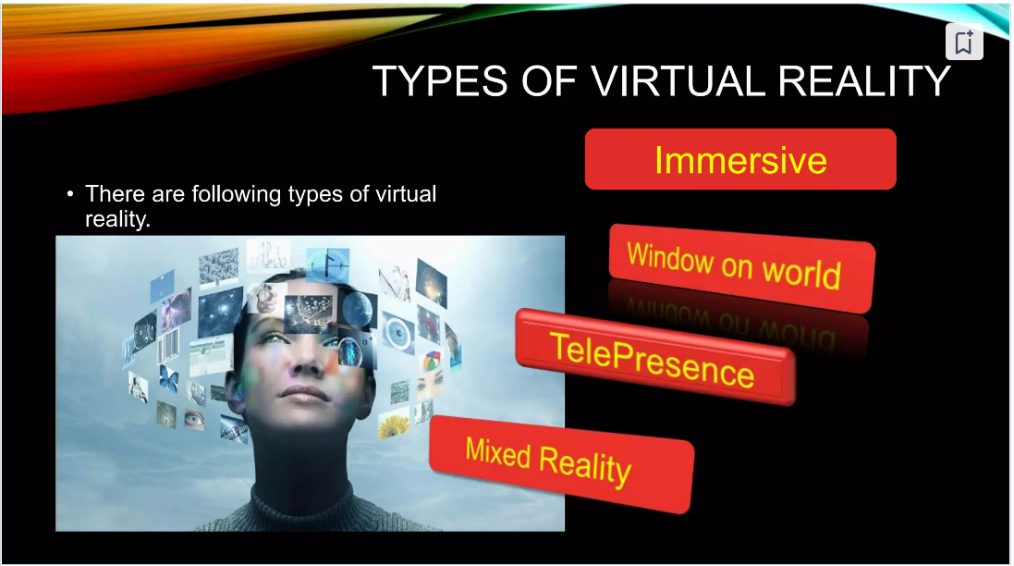

Slide 6
Types of Virtual Reality
Virtual Reality (VR) comes in several types, depending on the level of immersion, interaction, and the tech used. Here's a quick breakdown of the main types of VR:
1. Non-Immersive VR
What it is: VR where users interact with a virtual environment via a computer screen, but they’re not fully "inside" the virtual world.
Examples:
Video games like The Sims or Flight Simulator
Architectural walkthroughs on a PC
Tech needed: Monitor, keyboard/mouse/gamepad

Slide 7
Types of Virtual Reality
2. Semi-Immersive VR
What it is: Provides a deeper sense of presence using large screens or projections, but you’re still aware of the real world.
Examples:
Flight/train simulators
Museum installations with interactive projections
Tech needed: High-end PCs, large displays, sometimes motion tracking
3. Fully Immersive VR
What it is: The most common and advanced form—puts you entirely in a 3D virtual world where you can move, look around, and interact.
Examples:
Gaming on Meta Quest, HTC Vive, PlayStation VR
VR training in healthcare or military
Tech needed: Head-mounted display (HMD), motion controllers, sensors

Slide 8
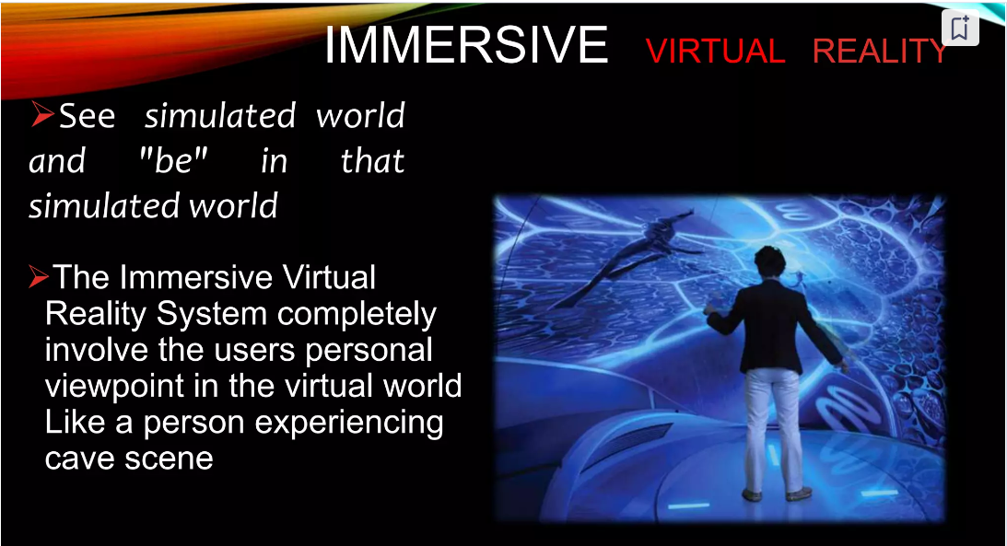

Slide 9
Types of Virtual Reality
4. Collaborative / Networked VR
What it is: Shared virtual environments where multiple users interact in real time.
Examples:
VRChat, AltspaceVR, Horizon Worlds
Remote workspaces or classrooms in VR
Tech needed: VR headset + internet connection
5. Augmented VR / Mixed Reality (MR)
What it is: Combines real and virtual elements—real-world views overlaid with 3D virtual content. Kind of a blend between VR and AR.
Examples:
Microsoft HoloLens, Apple Vision Pro
Tech needed: MR-capable headset, sensors for real-world mapping

Slide 10
Types of Virtual Reality
6. CAVE Systems (Cave Automatic Virtual Environment)
What it is: Rooms where images are projected onto walls/floor/ceiling, creating an immersive space without a headset.
Examples:
University research labs
Industrial design walkthroughs
Tech needed: Projectors, tracking systems, 3D glasses

Slide 11
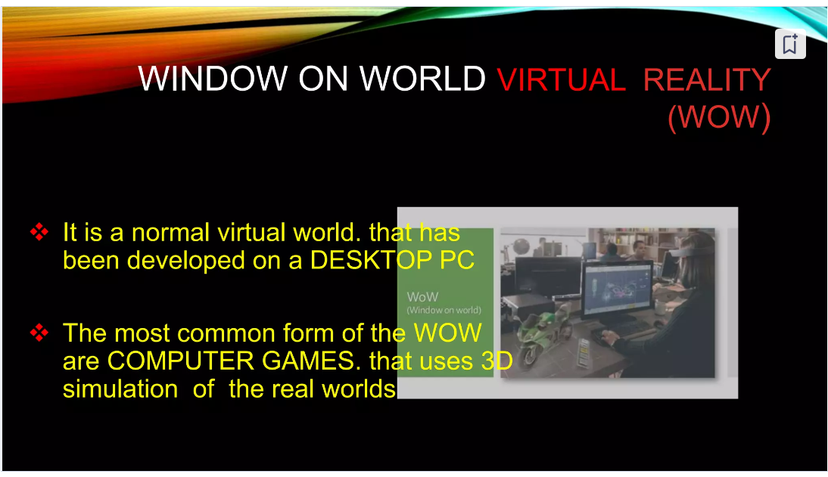

Slide 12
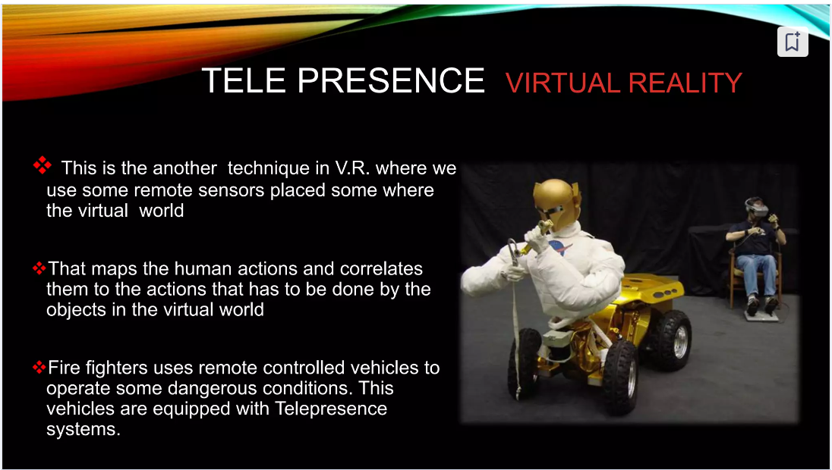

Slide 13
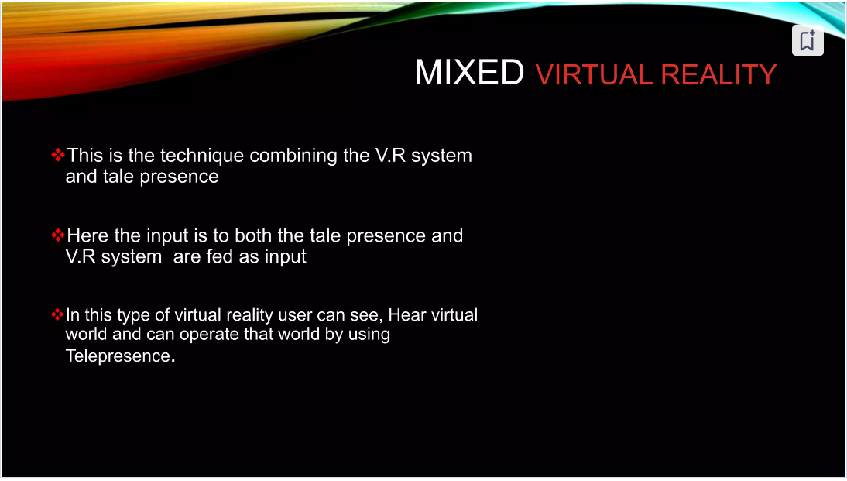

Slide 14
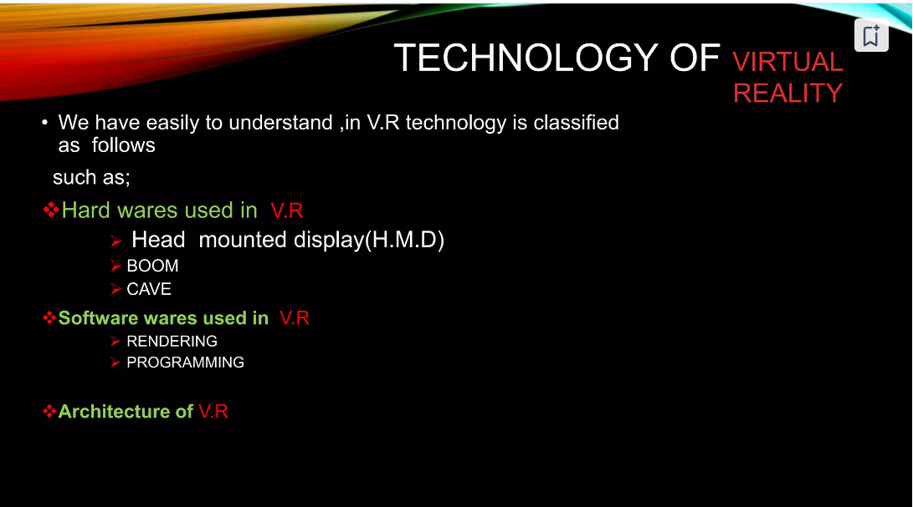

Slide 15
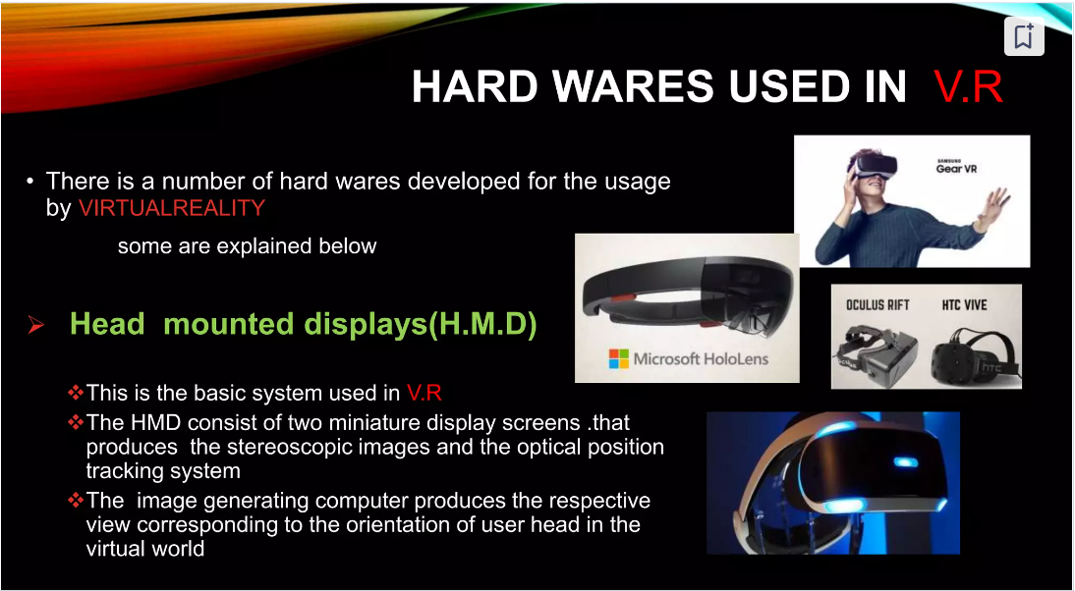

Slide 16
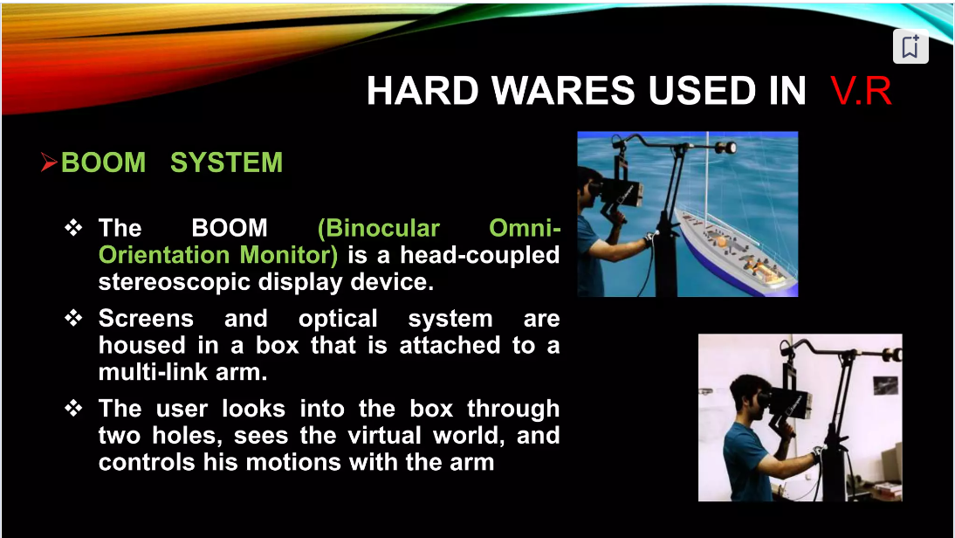

Slide 17
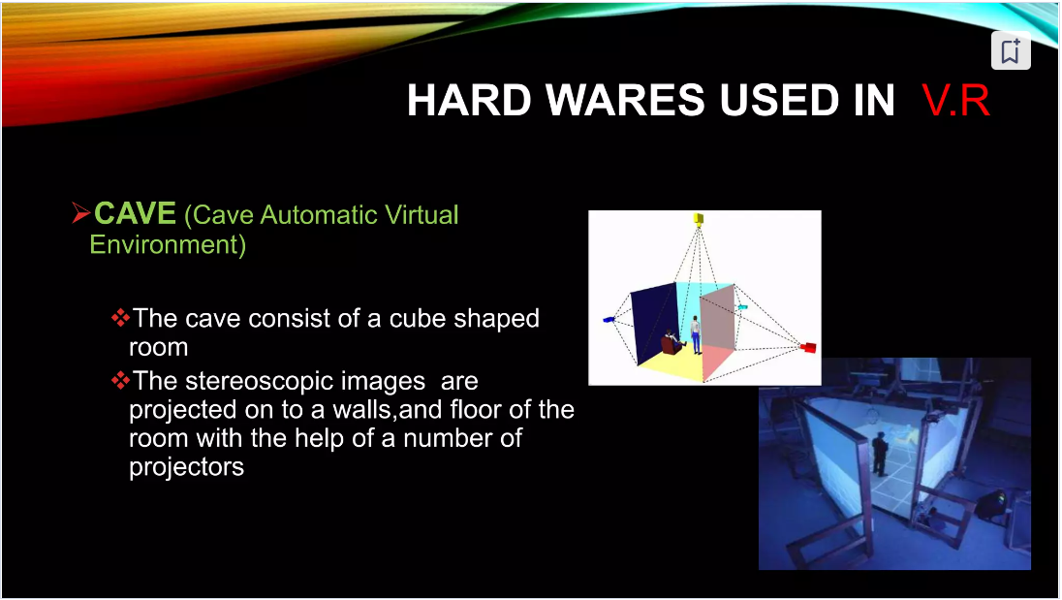

Slide 18
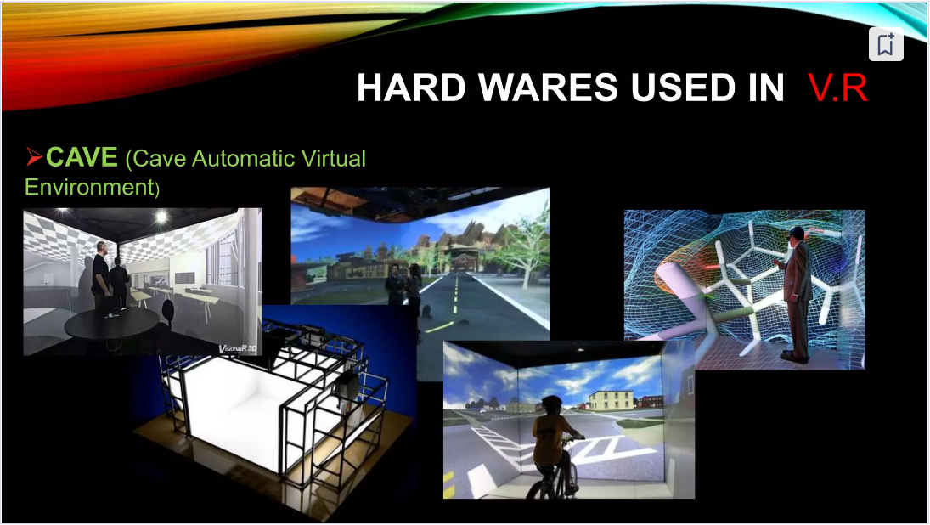

Slide 19
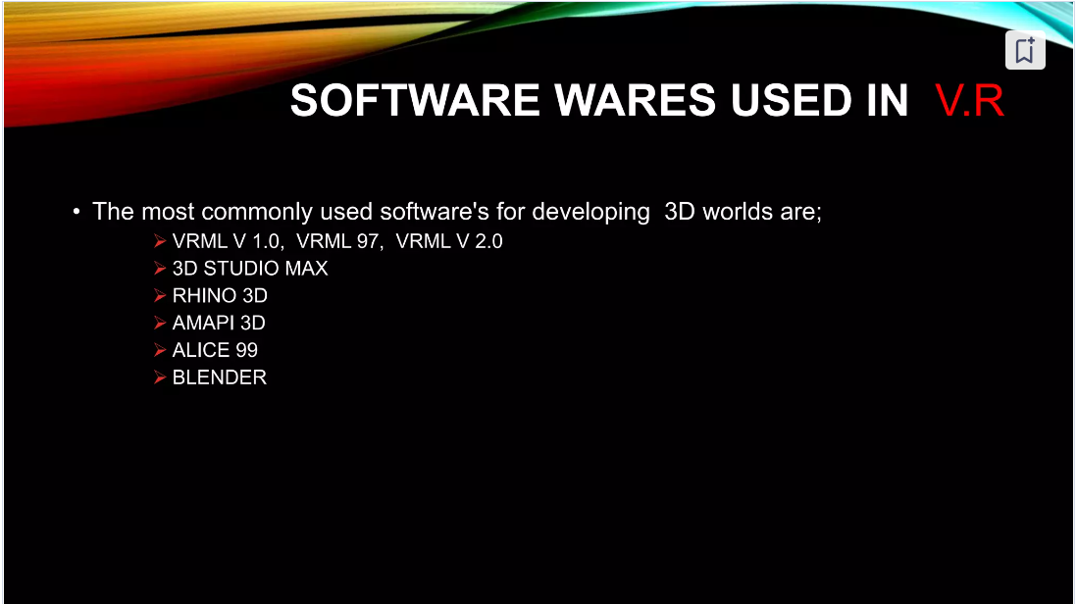

Slide 20
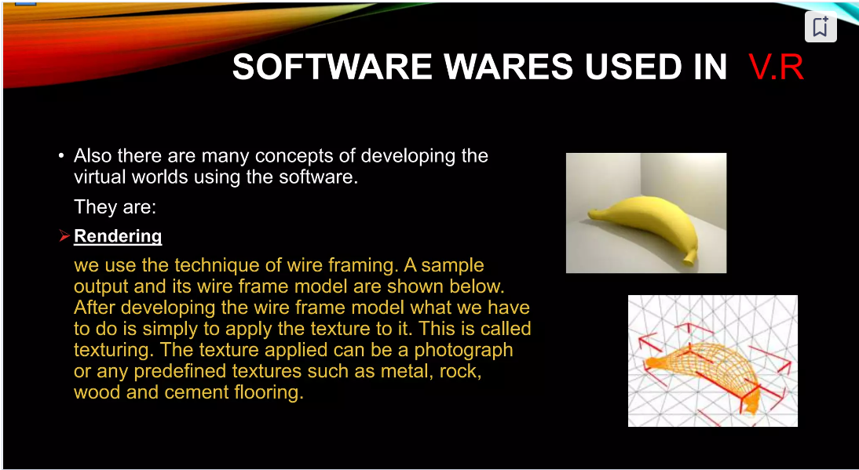

Slide 21
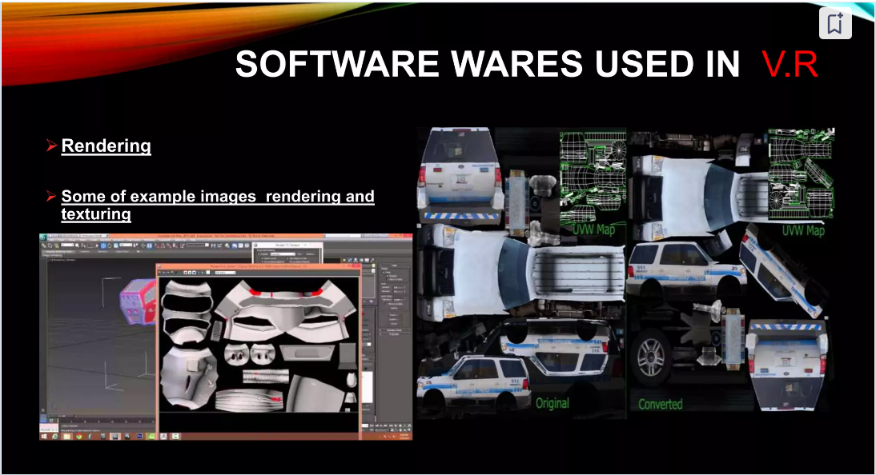

Slide 22
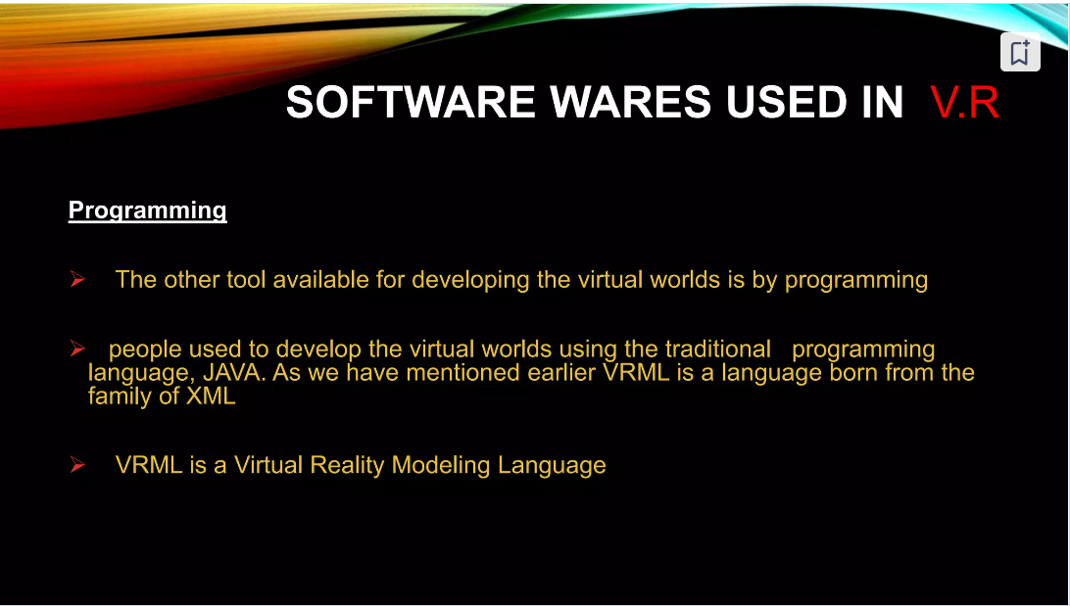

Slide 23
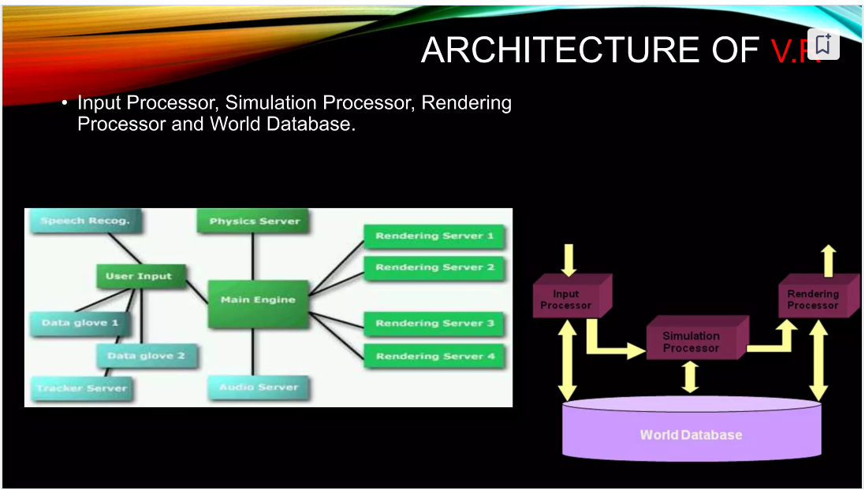

Slide 24
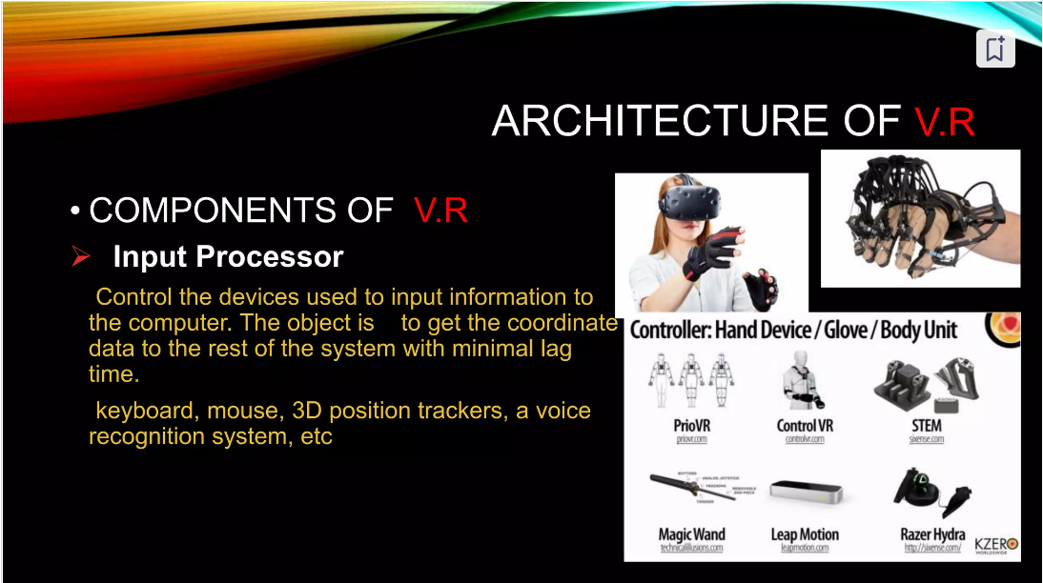

Slide 25
Architecture of VR
1. Input Processor
Purpose: Captures user input.
Examples:
Data gloves
Trackers (for head/body motion)
Speech recognition systems
Function: Converts physical actions into digital signals that can be understood by the system.

Slide 26
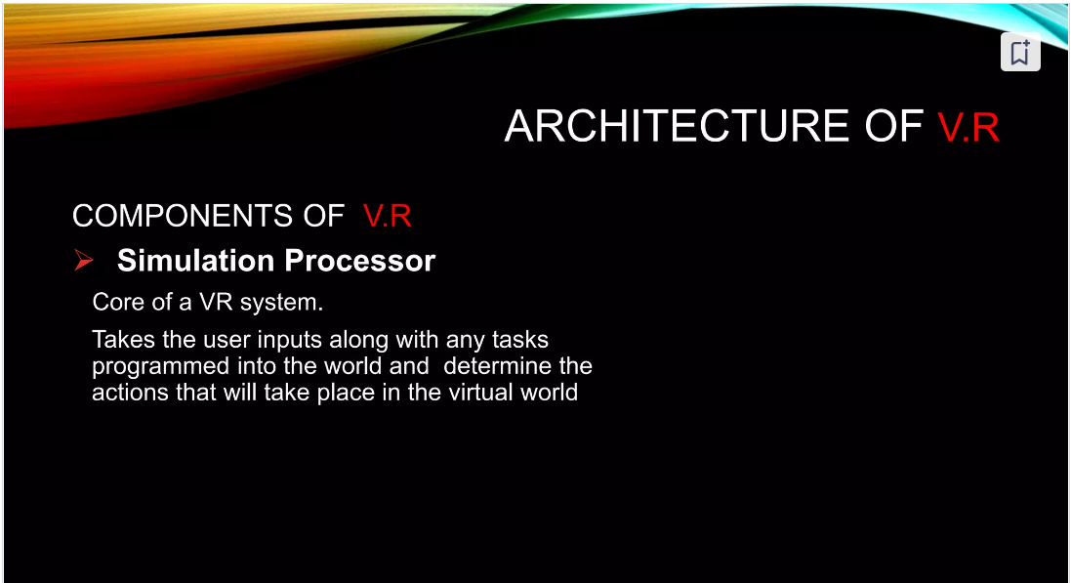

Slide 27
Architecture of VR
2. Simulation Processor
Purpose: Acts as the brain of the system.
Function:
Maintains the internal model of the virtual world.
Updates the state of the virtual environment based on user actions and physics.
Integrates input with the current world state using logic, AI, and physics servers.

Slide 28
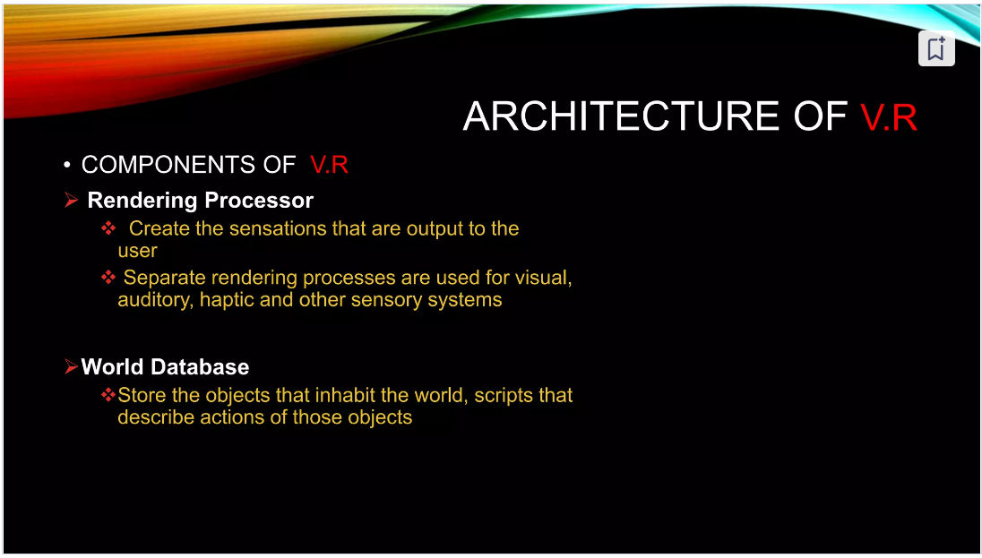

Slide 29
Architecture of VR
3. Rendering Processor
Purpose: Converts the updated virtual world model into sensory output that the user can perceive and interact with in real-time.
Types:
Visual Rendering: Responsible for generating realistic 3D graphics.
Uses rendering servers (as seen in the left-side diagram) to process images frame-by-frame.
Includes lighting, shading, texture mapping, and perspective.
Audio Rendering: Produces spatial and ambient sound that aligns with the virtual environment.
Often handled by audio servers.
Enhances realism and situational awareness.
Haptic Feedback: Provides tactile sensations (e.g., vibrations, pressure).
Delivered through data gloves, haptic suits, or other wearable devices.
Helps users “feel” interactions, adding another layer of immersion.
Goal: Deliver realistic, real-time output to immerse the user in the virtual environment.

Slide 30
Architecture of VR
4. World Database
Purpose: Stores the data that defines the virtual world.
Contents:
3D models
Textures
Sounds
Behavioral rules
Object properties

Slide 31
Architecture of VR
How They Work Together
The Input Processor captures what the user does.
The Simulation Processor updates the virtual world based on that input.
The Rendering Processor displays the updated virtual world.
The World Database feeds all three components with the necessary assets and rules.

